Slide 1
CSE 3200: System Development Project
E-commerce website based on reverse image search technology
Presented By: Ahsan Habib
Roll:1807064
Tashin Ahamed
Roll:1807083
Supervised By: Nazia Jahan Khan Chowdhury
Assistant professor
CSE,KUET.

Slide 2
Why we need visual based search?
“A picture is worth a thousand words.”

Slide 3
What is Reverse Image Search?
Reverse image search is a search engine technology that takes an image file as input query and returns results related to the image.
Two major things:
-Extract feature using Neural Network
-Calculate distance using K-Nearest Neighbors(KNN)

Slide 4
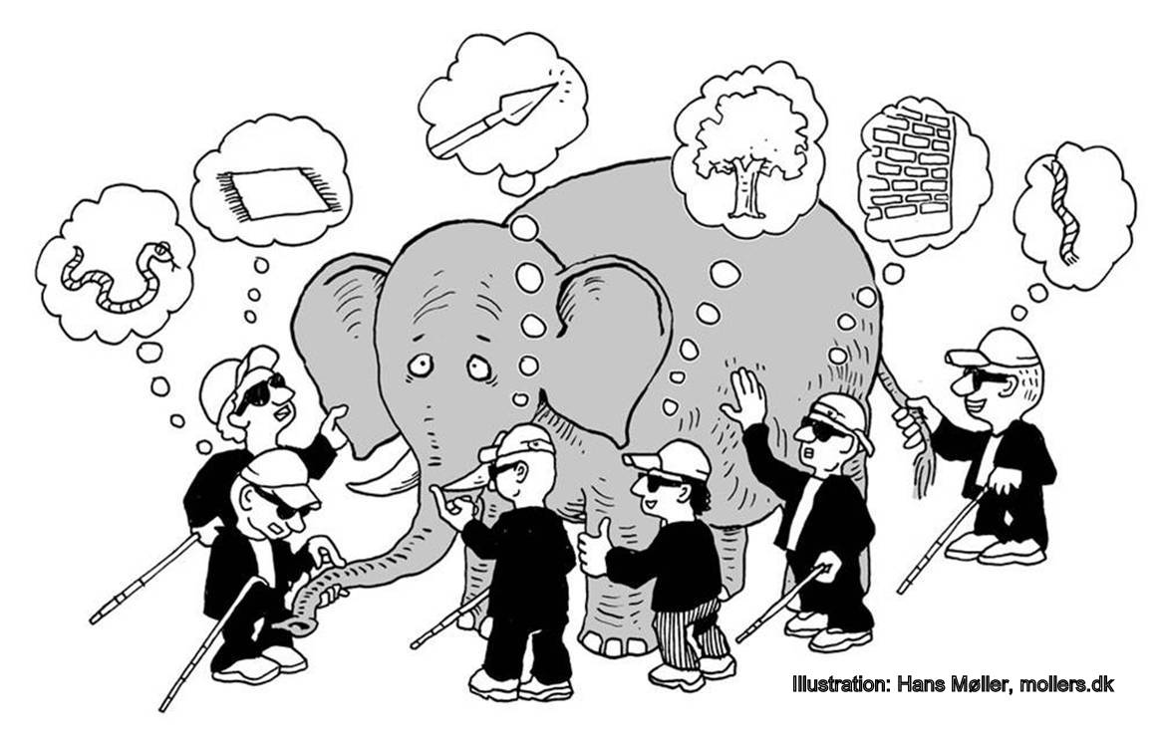
What is Neural Network?

Slide 5

How Neural Network works?

Slide 6
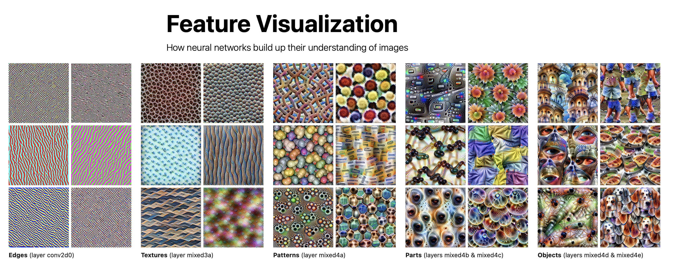
Features extraction of neural network
Edges
Textures
Patterns
Parts
Objects

Slide 7
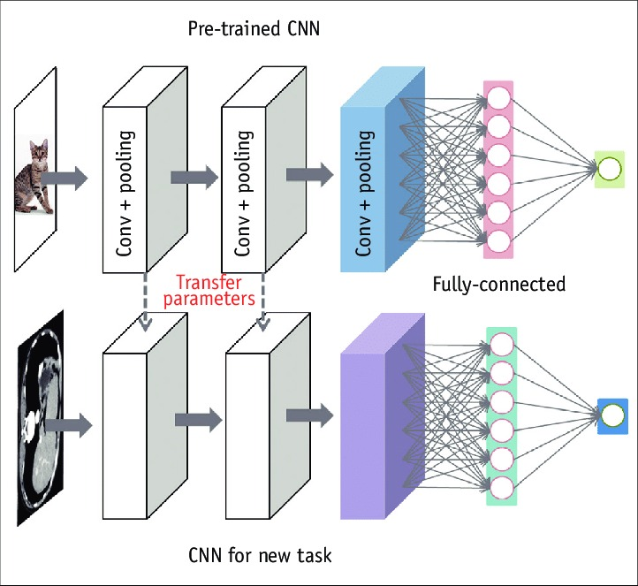
What is pre-trained model?

Slide 8
ImageNet
There are some popular pretrained models from ImageNet competition.
VGG16
Xception
InceptionV3
MobileNet
ResNet50
We’ve used ResNet50 as our pertained model.

Slide 9
Why Resnet50?
The solution of vanishing gradient problem…

Slide 10

Activation function

Slide 11
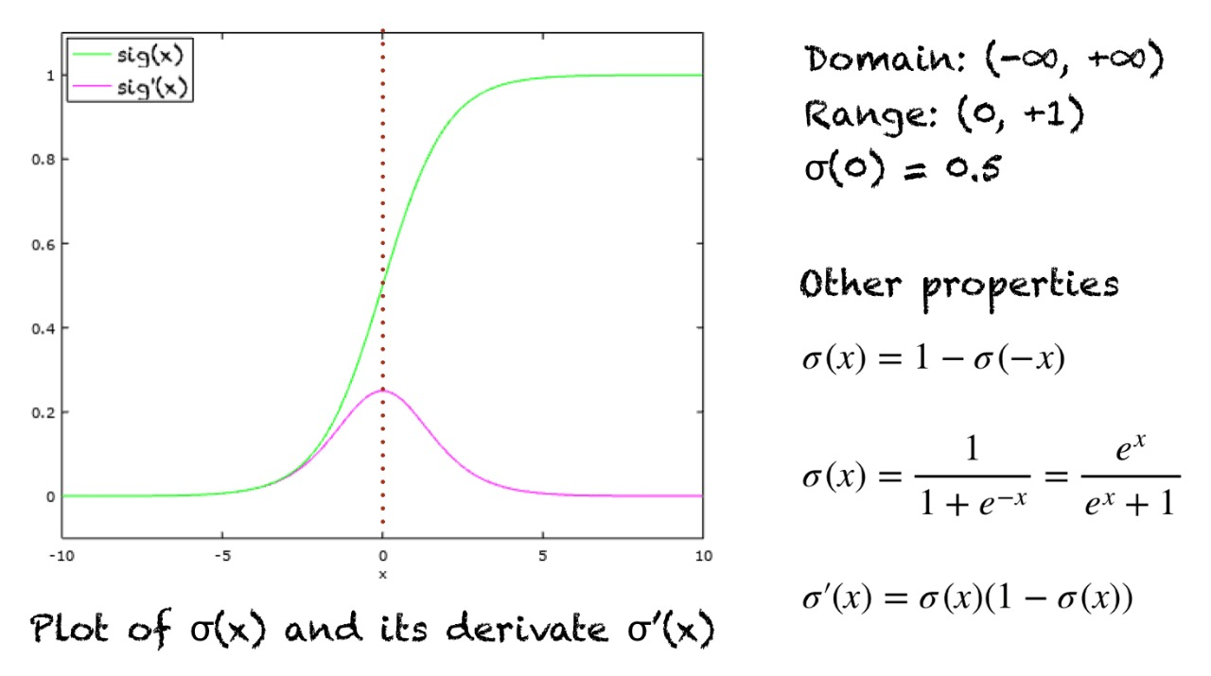
Sigmoid

Slide 12
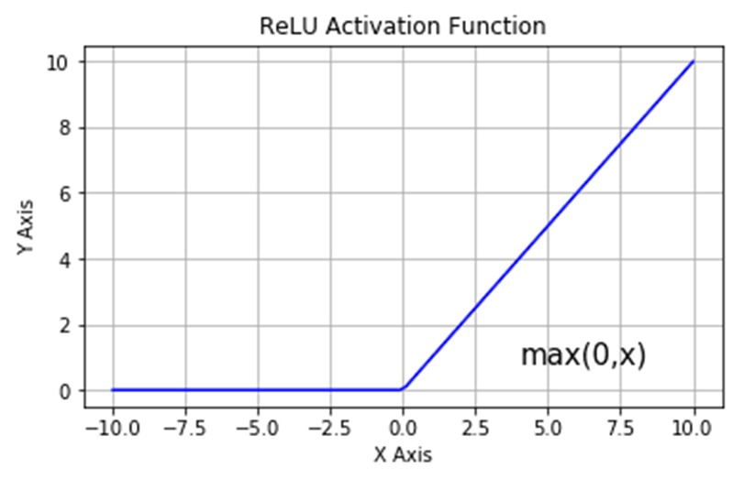
Rectified linear unit(ReLu)

Slide 13
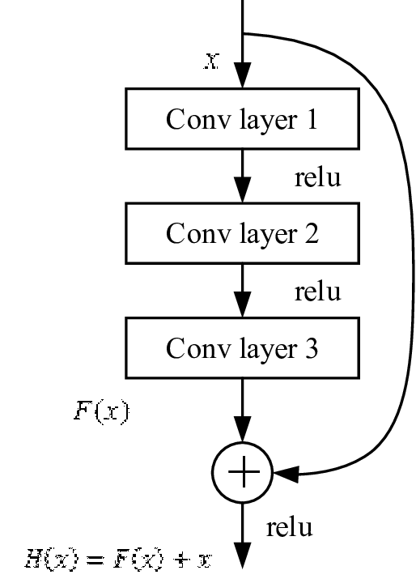
Skip connection(the solution of vanishing gradient problem)

Slide 14
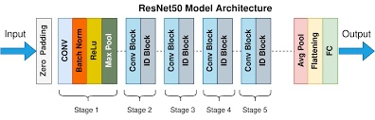
How reset50 works?

Slide 15
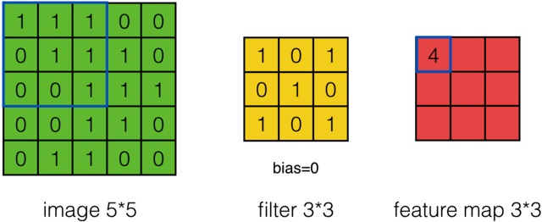
How filtering on image works?

Slide 16
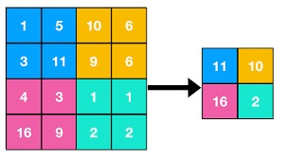
Max Pooling

Slide 17
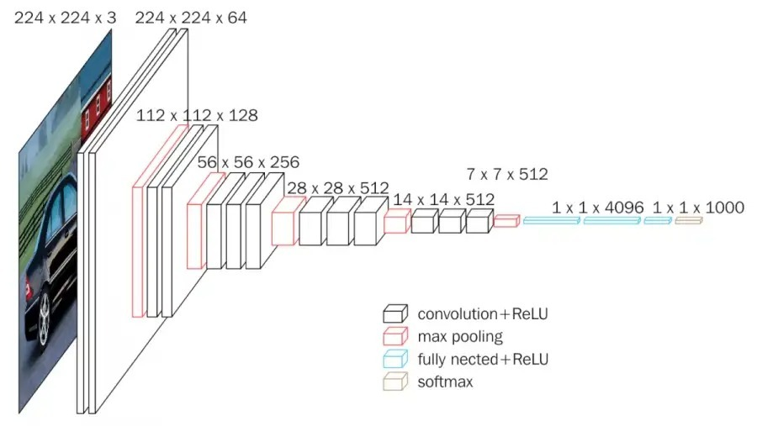
Dropping out fully connected layer

Slide 18
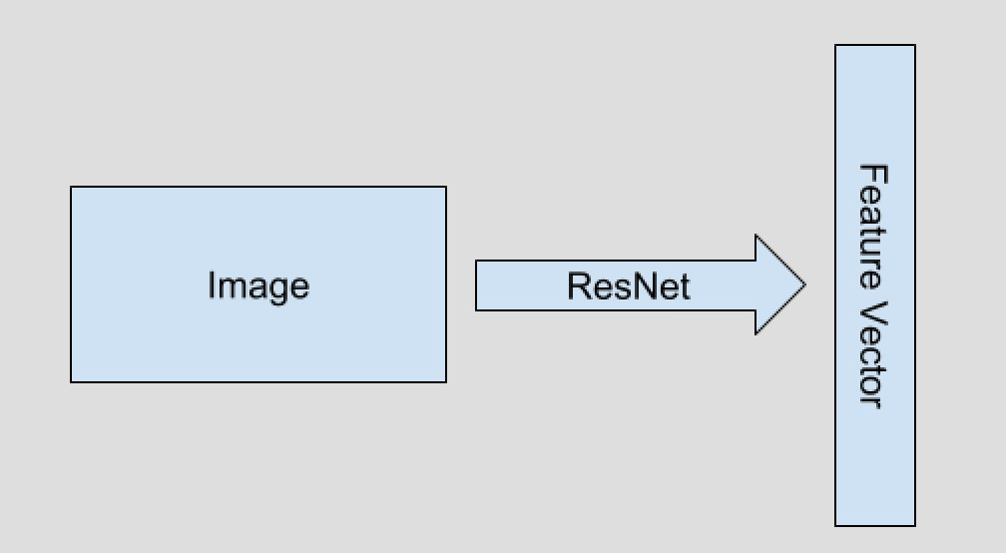
The ultimate output of an image(Feature vector):

Slide 19
Neighbors
Now we have the feature vector. We can use K-Nearest Neighbor(KNN) to find related image.

Slide 20
Ball tree algorithm(optimized KNN)
Step 2:
Step 1:

Slide 21
Step-3:
Step-4:

Slide 22
Step-5:
Step-6:

Slide 23
Step-7:

Slide 24
All the above 7 steps are repeated again in each individual ball and the data is further divided into smaller balls.

Slide 25
Prediction using Ball Tree

Slide 26
Platform
Using Django and Angular.

Slide 27
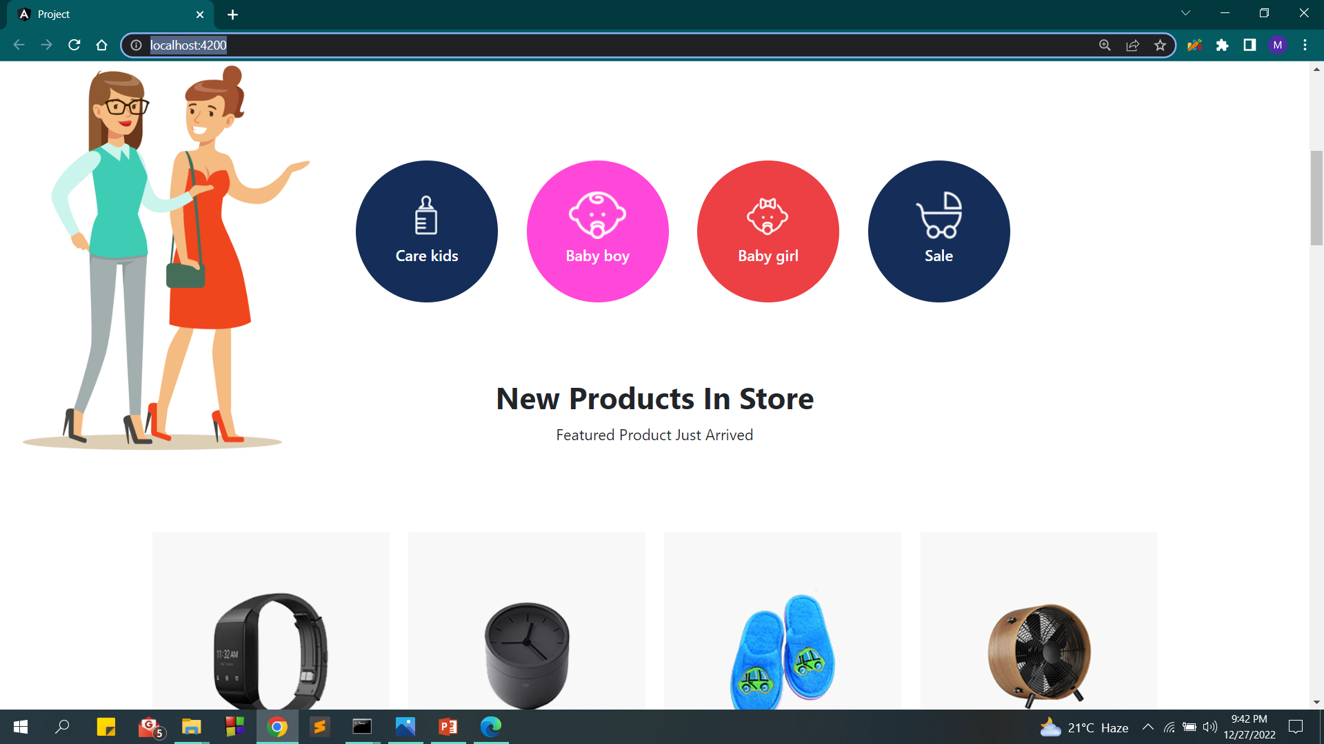

Slide 28
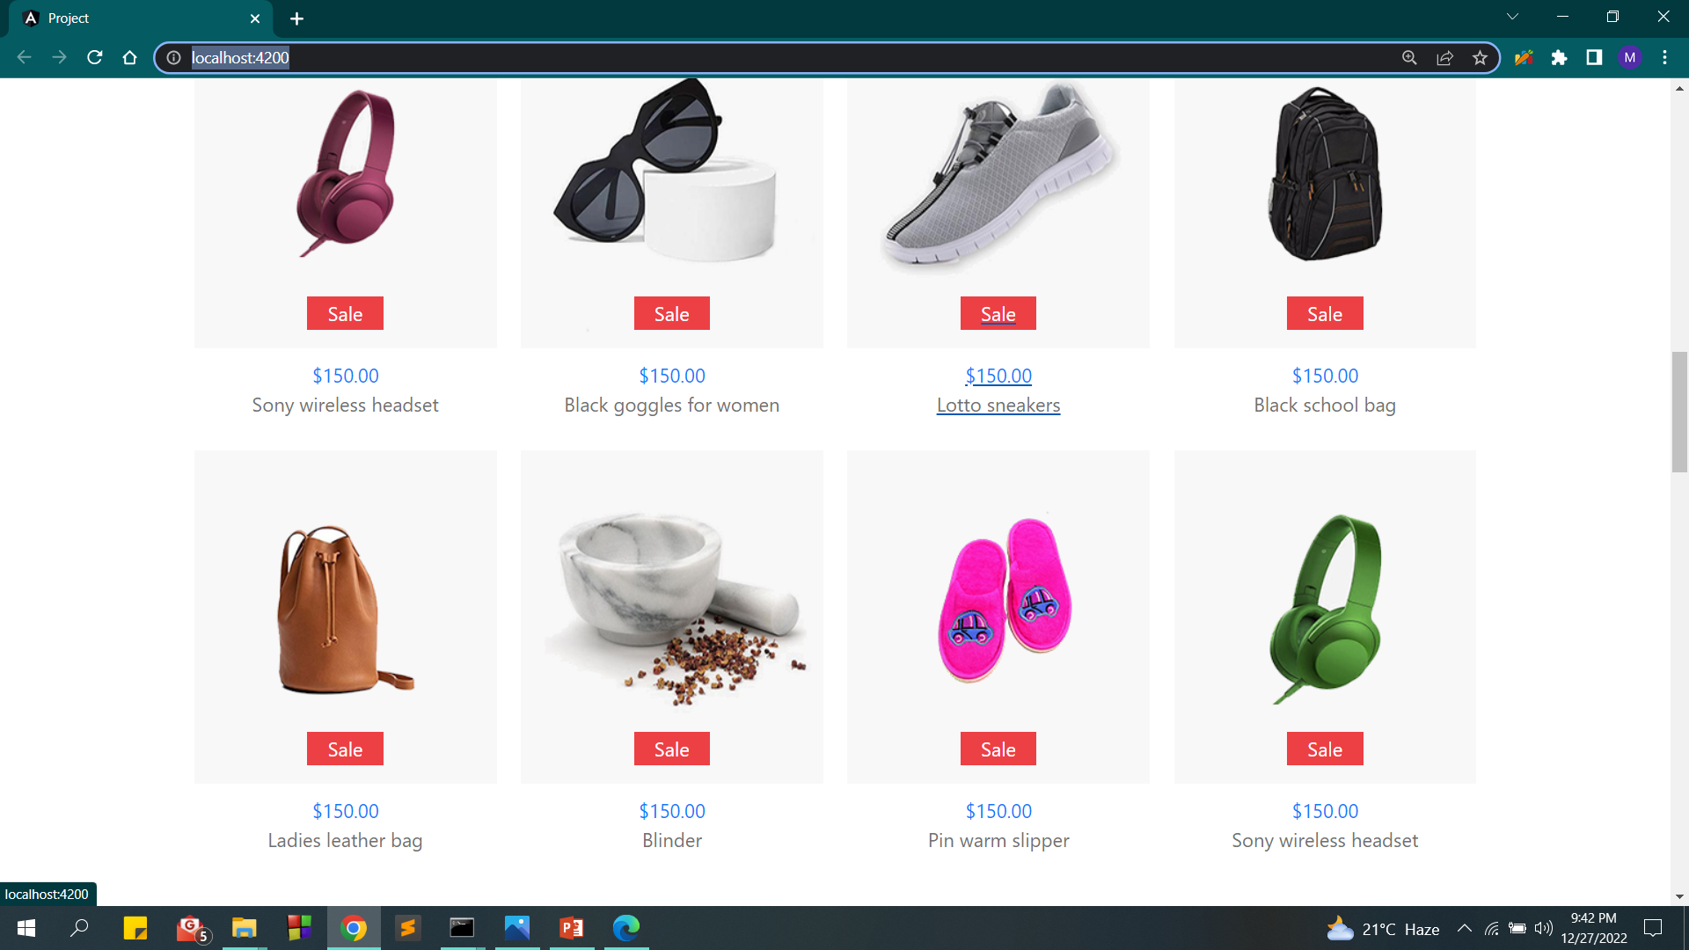

Slide 29
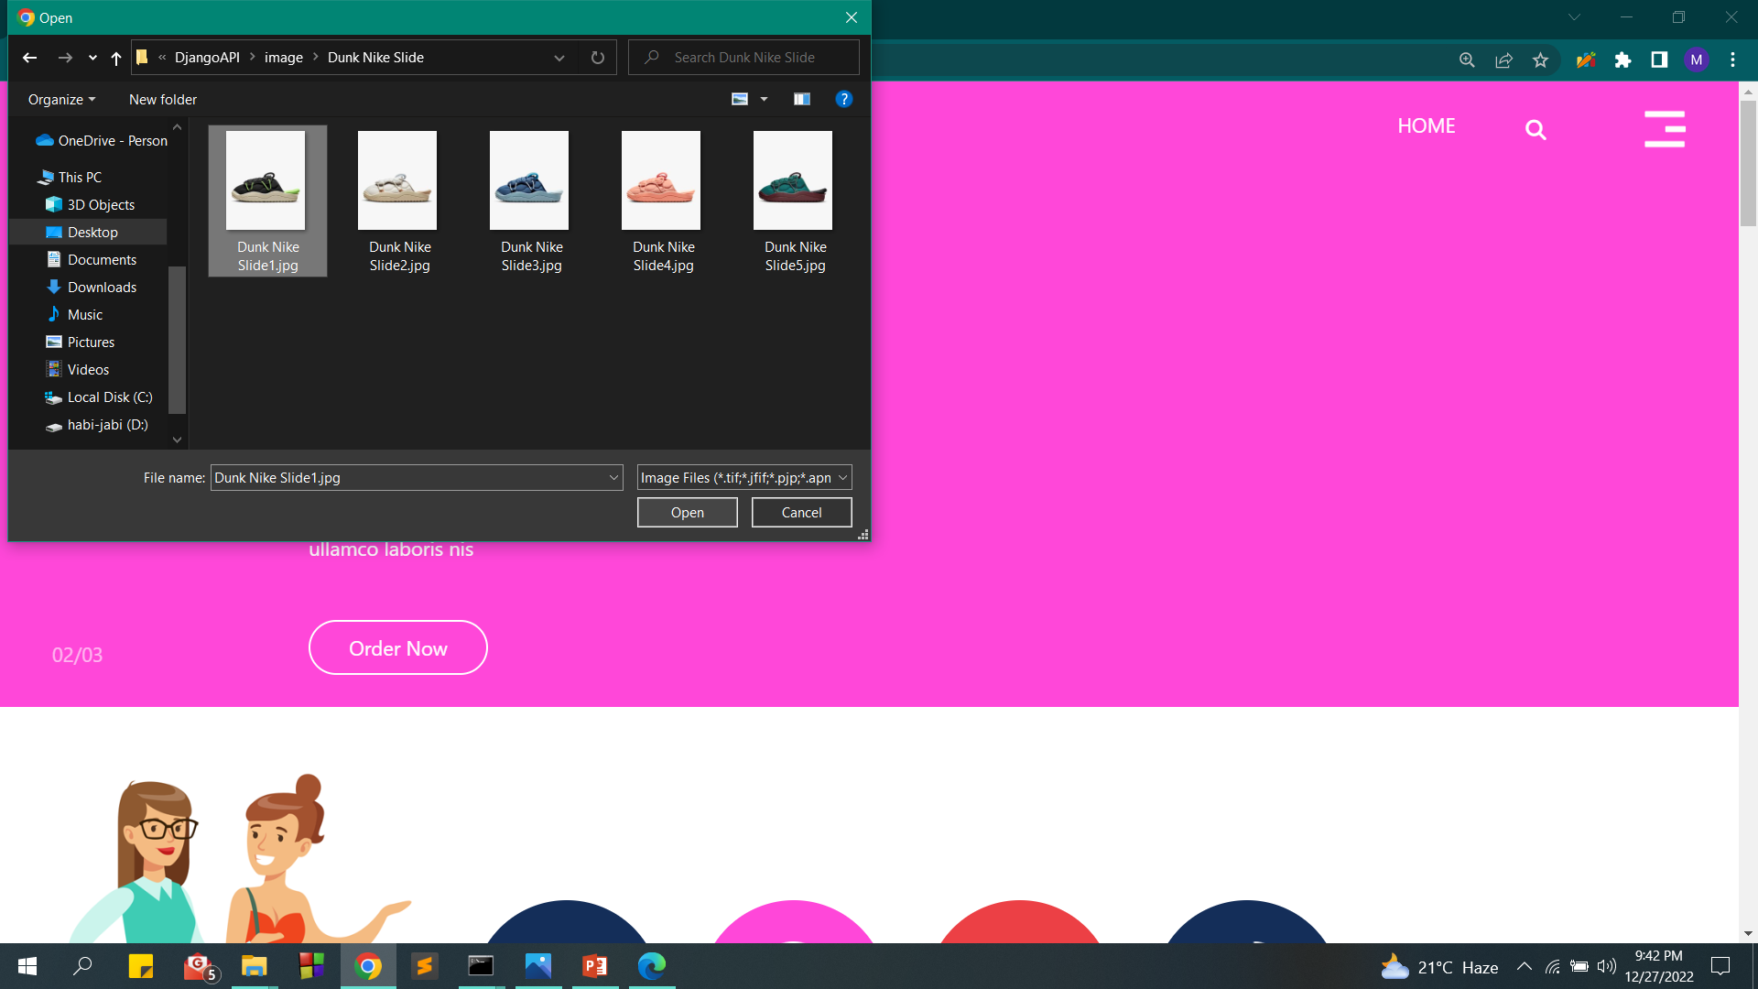

Slide 30
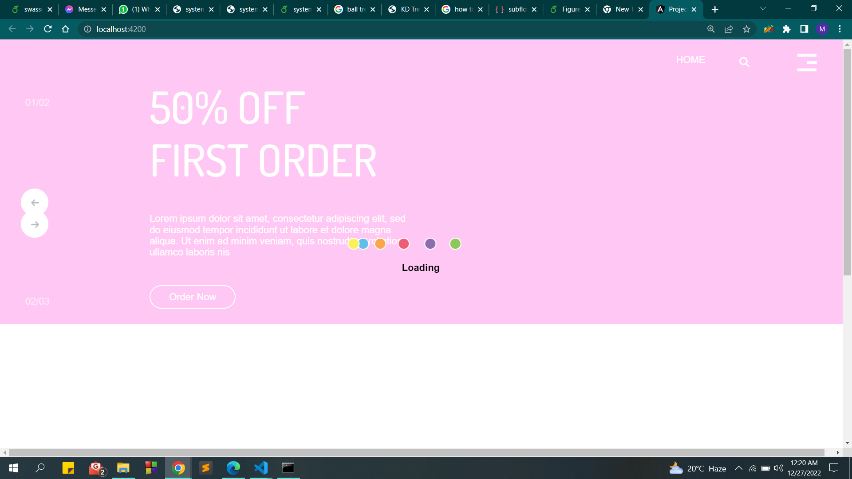

Slide 31
We searched for this image:

Slide 32
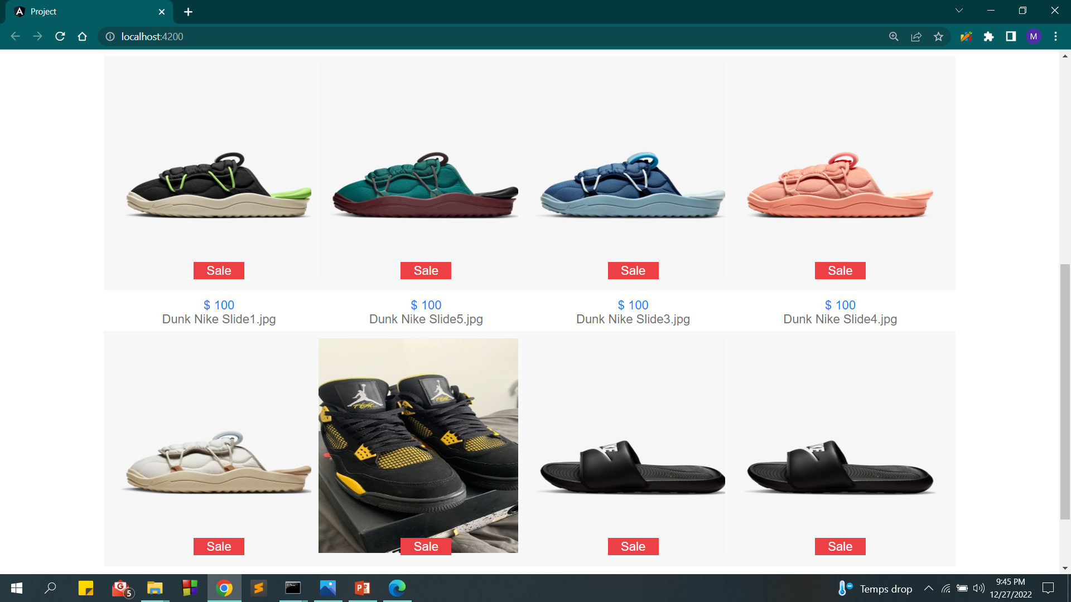
And we got this result:

Slide 33
Thank you.

